Slide 1

Admas University
Project Title
Online Educational Certificate Verification System For Admas University

Slide 2
Welcome To Our
Presentation

Slide 3
Project Title:-Online Educational Verification System For Admas University
Prepared By:-
No Full Name Id_no
1. Eferata Melekea ................................................1900/15
2. Aschalewu Abebe...............................................1673/15
3. Eman Hashim......................................................2385/15
4. Medhin Mehari...................................................0348/15
Advisor Name: - HagosG(MSc.)

Slide 4
Presentation outline
Introduction
Statement of the problem
Objective of the project
Scope of the project
Functional and Non-Functional Requirement
Use case diagram & Class Diagram
Hardware Software Mapping & Security Level
Implementation
Conclusion
Recommendation

Slide 5
INTRODUCTION
In many governmental and non-governmental institutions, including Admas University, after graduation, students must ensure that their academic credentials are accurate from which academic institution. This is what we call Educational Certificate Verification. In our project we want to avoid this time consuming and boring manual system. In order to overcome this problem, we have planned to design web based online Educational Verification system for every Student.

Slide 6
STATEMENT OF THE PROBLEM
Since Students have the right to proof for the evidence from the University and College. students after getting Certificate. If it is the certificate is valid or invalid. Then Come again to the university. But in this case they have to pass through much manual process. They have to visit registrar of the University and to be verify Educational Certificate. The process of proof evidence is boring and time consuming.

Slide 7
Cont.…..
Problems in the existing system
Student have to come to the registrar office for checking certificate
Checking certificate process takes more days
Searching information is difficult
It does not make the students trustworthy because currently they have a lot of false academic credentials

Slide 8
OBJECTIVE OF THE PROJECT
The overall purpose of this project will develop web based educational certificate verification system for Admas university
Our objectives will be: -
Study background of organization then Identifying problem of the current system
Analysis of the existing system then evaluate alterative solution
System analysis and Object design
Design different web page based on privilege
Implement and test the system until the organization needs is fulfill.

Slide 9
SCOPE AND LIMITATION OF THE PROJECT
Scope of Project
The scope of the project is about tasks that will be performed throughout the system. Our main goal in doing this system is making the existing manual into web based system, more efficient, less time consuming and overall a better working system and students and other customer can check and verify every student educational certificate information by using Our system.
Limitation of Our System
The system does not verify student grade report and student payment system for each service.

Slide 10
Development Tools and Technologies
For our proposed system we need the following Hardware and Software specifications.
Frontend Technologies
Notepad++,HTML 5,CSS,JavaScript,bootstrap,Adobe Photo Shop cs4.
Backend Technologies
Notepad++, PHP 5,MYSQL 5
Document and Modeling Tools
Edraw Max,Visio ,Ms-Word,Ms_Excel,Ms_Powerpoint,Nitro PDF.
Deployment Environment
xampp-win32-5.6.38 , Mozilla Firefox 54.0b7.

Slide 11
DESCRIPTION OF THE EXISTING SYSTEM
The online educational verification system project is a Greenfield engineering project. There is no current system to replace and the task of OECVS is not accomplished by now. But temporarily the Admas University works in a traditional way that it’s impossible to say a manual system to check Student Certificate that is an organized to work and more time consuming.

Slide 12
Drawbacks of the Existing System
The existing system had many problems. For example, if the student wants to check certificate from the university by tradition way .
✓ The Process of proof evidence is boring and time consuming.
✓ To Checking certificate process takes more days
✓ Student Certificate Paper is easily damaged
✓ Student Certificate Searching information is difficult

Slide 13
Functional Requirements
The functional requirements that the OECVS will provide
✓ Create and delete, update maintain and manage accounts.
✓ Register and update, delete students student certificate.
✓ Check and verify for each student educational certificate
✓ It has User login and logout.
✓ Views the educational certificate.
✓ Generating certificate report and user report.

Slide 14
Non-Functional Requirements
The system will have the following features.
✓ User Interface and Human Factors
✓ Hardware Consideration and Physical Environment
✓ Security Issues and Quality Issue
✓ Performance Consideration and Resource Issues
✓ Error Handling and Validation
✓ Backup and Recovery
1

Slide 15
SYSTEM ANALYSIS
System Analysis:-it is a process of collecting and interpreting fact, identifying the problems, and decomposition of a system into its components. And what the system should do.
System Model(Functional Model)
System modeling is used to describe the system under development by showing its functionality using use cases, static behavior using class diagram and dynamic behavior using sequence and activity diagram.

Slide 16
Use case Scenario
Our System Scenarios are to use a use case explaining a concrete major set of action. Our System Scenarios are web application so our system scenarios first open any Web browser like Mozila,Chrome etc. then on web browser write address of OECVS Domain name then opening ours system then after that you can get search text field that you want to check own certificate by using student certificate Number first write on search engine then you can check and verify own certificate.

Slide 17
Use case Model
Use cases provide to capture system requirements, and communicate with the end users. A use case is best to identify the actors and defining how the actors will be able to interact with the system.so we have to identify each actor with use case for our system. So our system has 3 Actors ,9 Use Case and Our system name. so let us see Our system Use Case Diagram

Slide 18
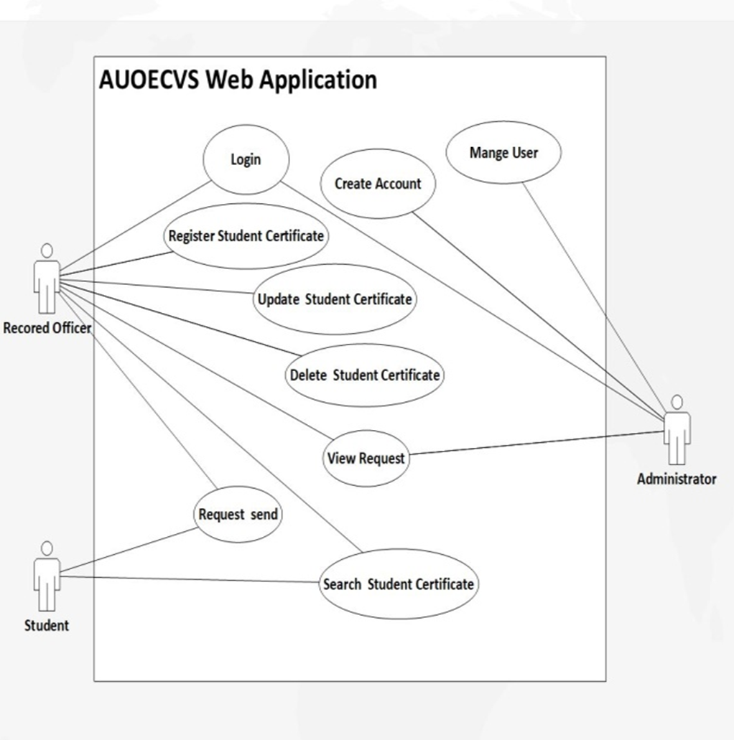
This is UML Use Case Diagram

Slide 19
Object Model
Object is an instance of a particular moment in runtime, including objects and data values. A static UML object diagram is an instance of a class diagram; it shows a snapshot of the detailed state of a system at a point in time, thus an object diagram encompasses objects and their relationships at a point in time. It may be considered a special case of a class diagram or a communication diagram.

Slide 20
Class Diagram
A class diagram is a static model that describes the object structure of a system in terms of Classes, objects, attribute operations and associations between different objects. Identified classes and their associations for the system is represented. so let us see Our system Class Diagram.

Slide 21
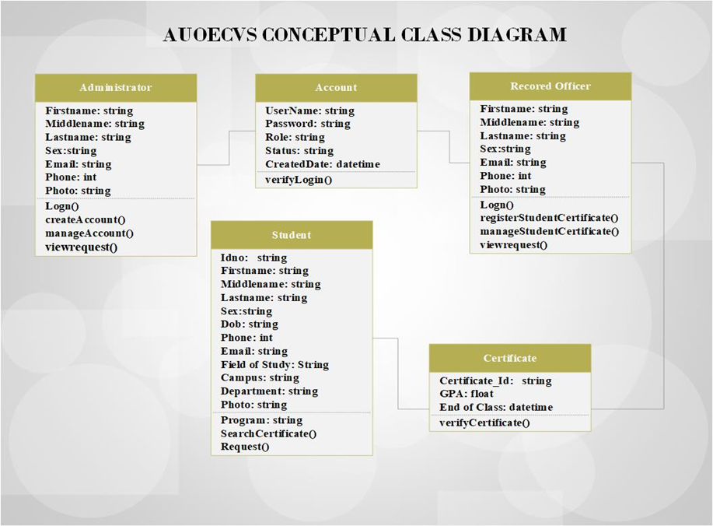
This is UML Class Diagram

Slide 22
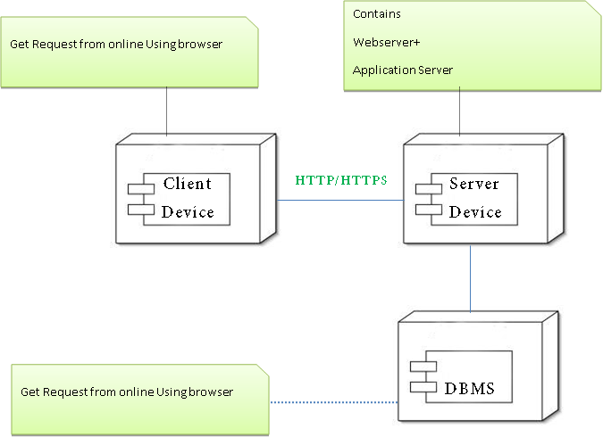
Hardware Software Mapping Design

Slide 23
Access Control and Security
Access control and security describes the user model of the system in terms of an access privilege. Utilize global access table, describing the access relation between the actors, objects and operations in the system. You can use tables to show the privilege assigned to each users of the system. This section also describes security issues, such as the selection of an authentication mechanism, the use of encryption, and the management of keys.

Slide 24

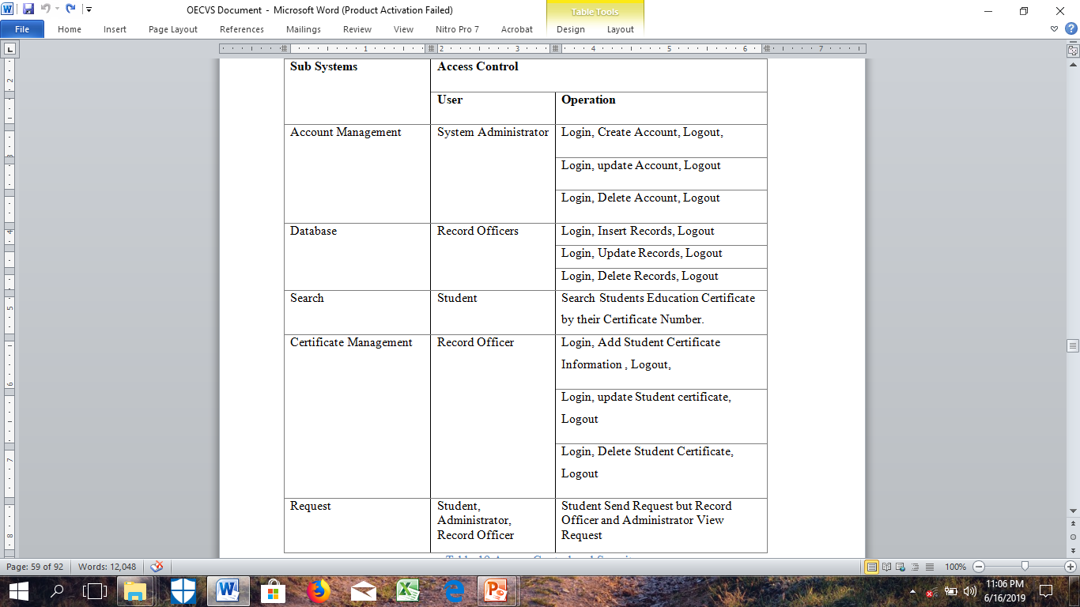
Access Control and Security
Access Control and Security

Slide 25
Implementation
Implementation is the final stage where the theoretical design is turned into a working system.
The most crucial stage in achieving a new successful system and in giving confidence on the new system for the users that it will work efficiently and effectively.

Slide 26
Implementation of Database
Our system database implementation is we used appropriate database management system, that means all tables which were identified and shown as persistent model in the design document should be created with their primary keys, foreign keys, check constraints and unique constraints. Our database normalized from 1st to third normal form for example student table into 3 table normalized for Certificate, Department, Campus. And Configure a schedule of database backup always backup during logout every system user.

Slide 27
Configuration of Application Server
Here we uses an appropriate application server for their development
Properly start and shutdown the application server.
Organize AUOECVS folders and files on the server properly
Separation of application server and database we use Xampp Server and Database name AUOECVSDB.
Configure the server to work on different port number we use
80, 3306.

Slide 28
Configuration of Application Security
Here we uses an appropriate application security
We Implement all input validations properly just like Invalid User Name & Password
We Implement MD5 encryption/decryption
Roles must be defined clearly
User accounts must be assigned with necessary access privileges for
Example: - Our system user either Registrar or System admin.
We implemented Sessions before login and after logout the system.

Slide 29
User Interface Design
User Interface design is the process of putting clear visualization and graphical sample of the designed web application. We design our system user interface is user centered design (Place users in control of the interface) Reduce users’ memory load and the user interface consistent. Show simple user interface from our project.

Slide 30
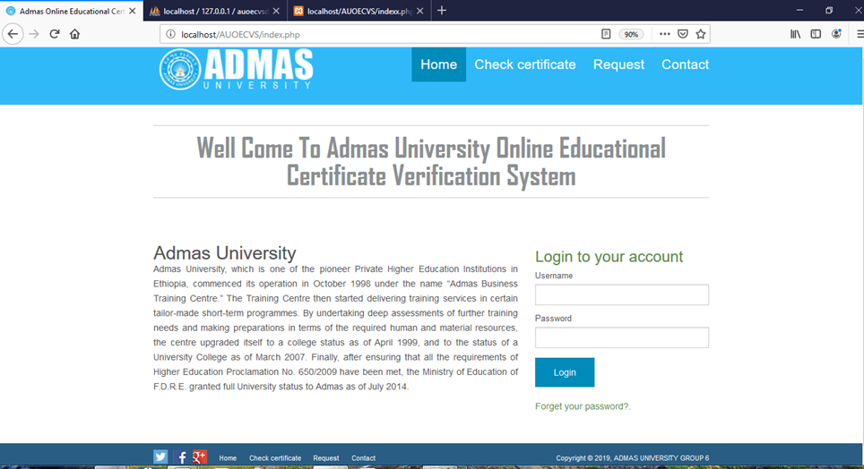
Desktop View

Slide 31
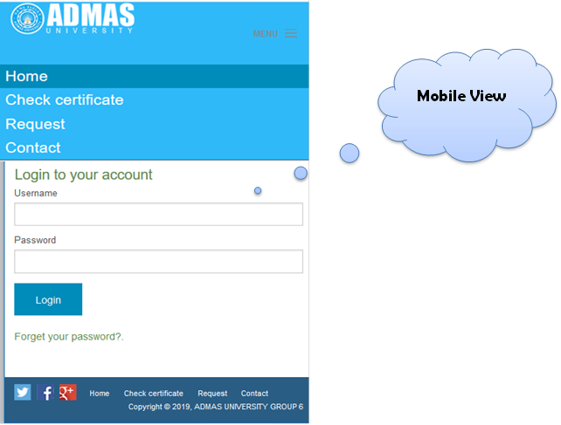

Slide 32
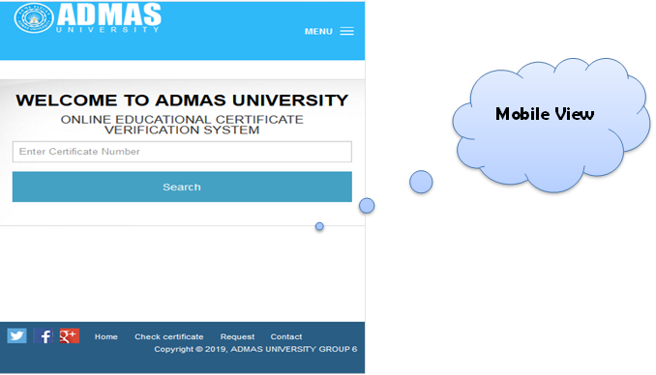

Slide 33
Testing
The testing involves evaluating the developed system using various kinds of data. In this part the designs phase is translated into code. In addition to this we would create administrator account to administrator of the whole system, and use the backup devices to protect the system’s records. There were different types of testing strategies such as unit testing, integration testing, system testing, user acceptance testing.

Slide 34
Conclusion
In comparison with the manual educational certificate verification System way , the benefit under a computer system considerable in to saving of manpower, working hour and efforts. It can observe that the information required can be obtained with easy and accuracy in the computerized system to check certificate. The user with minimum knowledge about computer can be able Operate the system easily. This system can be used by any university as it can be customized easily additional features can be added without interrupting the normal functioning of the system.

Slide 35
Recommendation
To accomplish all works that we have written in this paper we have used different methods to understand the drawback of the current system, failure of the current system and advantages of using the new computerized system.
We have many reasons which force us to develop these check online educational certificate system. The problems were stated under the proposal and this project would definitely solve the problem. Therefore we recommend the organization implement this system on the existing system. So as a recommendation the team recommend the department to start using both systems. (That was the existing system and the new system).

Slide 36
Thank you!!!

